Slide 1
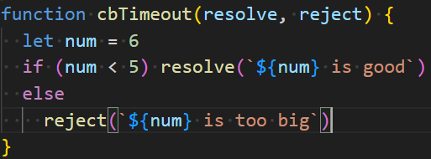
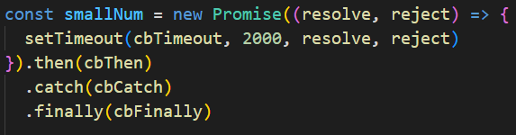



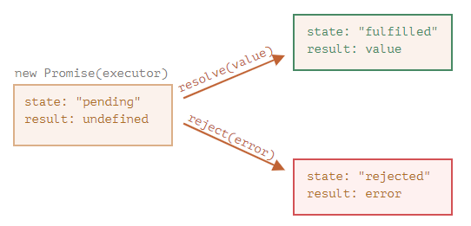

Written using named functions to illustrate sequence
Typically use arrow functions
Typically create promise in a function
demos/async/promise1.js
demos/async/promise1b.js

